Slide 1

Research Presentation
Marcella hovseth
Colorado State University Global
MIS581: Capstone: Business intelligence and data analytics
Module 8: Portfolio Project ( Video Link ) (Github – Hovseth)
Dr. Orenthio Goodwin
May 15, 2022

Slide 2


Introduction
184% increase
54% increase
Note. Adapted from “Job openings and labor turnover survey.” by BLS., 2022 Copyright 2022 by U.S. Bureau of Labor Statistics.
Notes:
COVID 19 was declared to be a pandemic by the World Health Organization (WHO) on March 11, 2020 (CDC Museum, 2022). Two years have passed since the declaration of the pandemic and COVID 19 is finally beginning a transition to an endemic phase which will take years to fully achieve (Antia & Halloran, 2021). Global changes and adaptations had to be made at an unprecedented rate. Because of efforts to contain the pandemic, the national job separation rate increased by 184% while vacancy applications and hiring decreased (Marinescu et al., 2021).
The graph shows that while the hire and separation rates have nearly returned to pre-pandemic rates, the number of job openings has seen a 54% increase overall. This suggests that many are long-term unemployed or have simply chosen not to return to work. As the pandemic has worn on, there has been a collective reassessment of priorities that led to what came to be known as The Great Resignation (TGR) (Geisler, 2021).

Slide 3


Research Objective
Notes:
The research study that accompanies this presentation focuses on the effect of the COVID 19 pandemic on population health in the United States. Specifically, the effect of the pandemic on employment and the economy are explored as they relate to population health. The objective of this research aimed to gain insight into factors that contribute to employee turnover (churn). The research strived to understand how employee retention rates can be increased. Research to better understand the impact of the pandemic in these areas will aid in understanding how stabilizing the labor market may, in turn, help improve population health.

Slide 4
Social Health Determinants
Population Health
Health Care
Health Behaviors
Socioeconomic Factors
Physical environment
Notes:
The pandemic and TGR have had a far-reaching impact. In addition to an unprecedented national loss of life, the pandemic has also notably impacted the nation’s population health and economy (Rigby, 2021). The World Health Organization (WHO) identifies population health as a synthesis of physical, mental, and social well-being (Shi & Singh, 2019). Employment, income, and wealth are critical health socioeconomic determinants and each of these facets of well-being has been impacted by the pandemic.

Slide 5
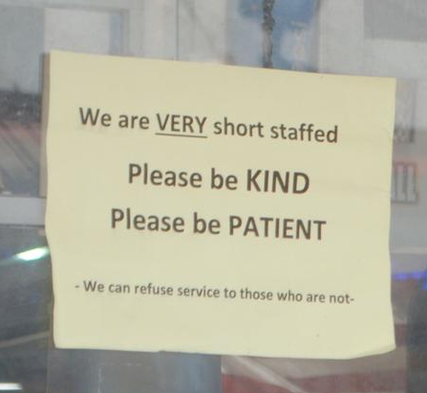

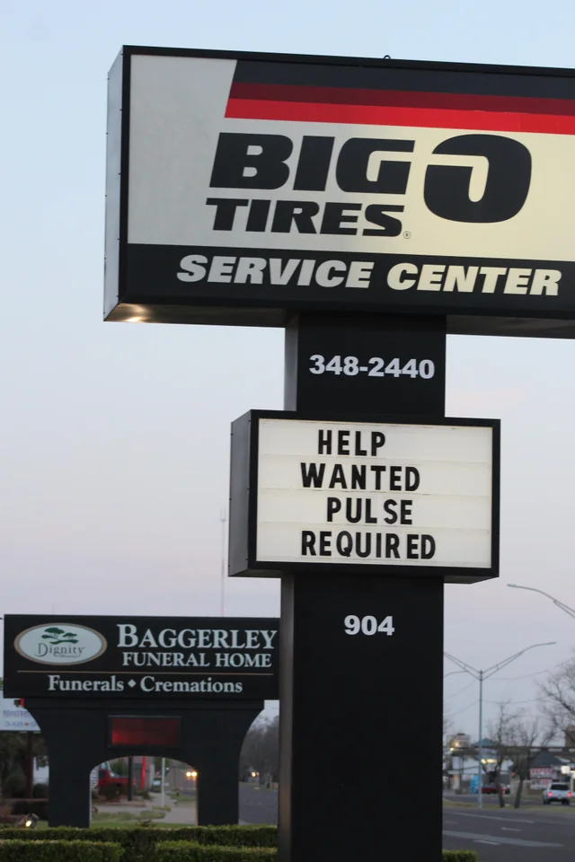
Employee Turnover
Notes:
Organizations are currently experiencing staffing shortages that are detrimental to the organizations, employees (Jagangac et al., 2020), and their customers. The current climate of the labor market dictates that organizations must do more with less human resources. Filling staff vacancies and reducing employee churn have become paramount for organizational longevity. The labor shortage exacerbated by the pandemic has resulted in many organizations raising wages, offering internal referral bonuses, and offering hiring bonuses (Choudhary, 2021).

Slide 6
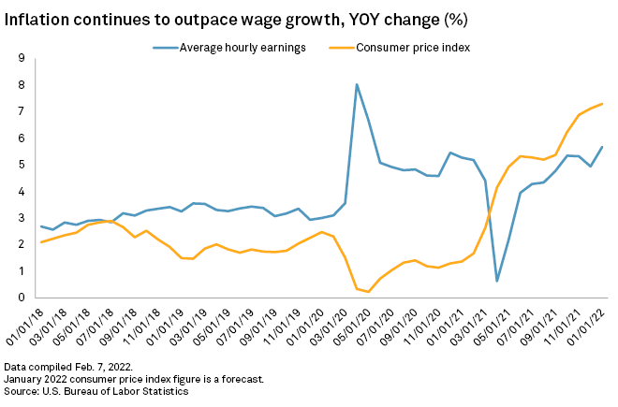
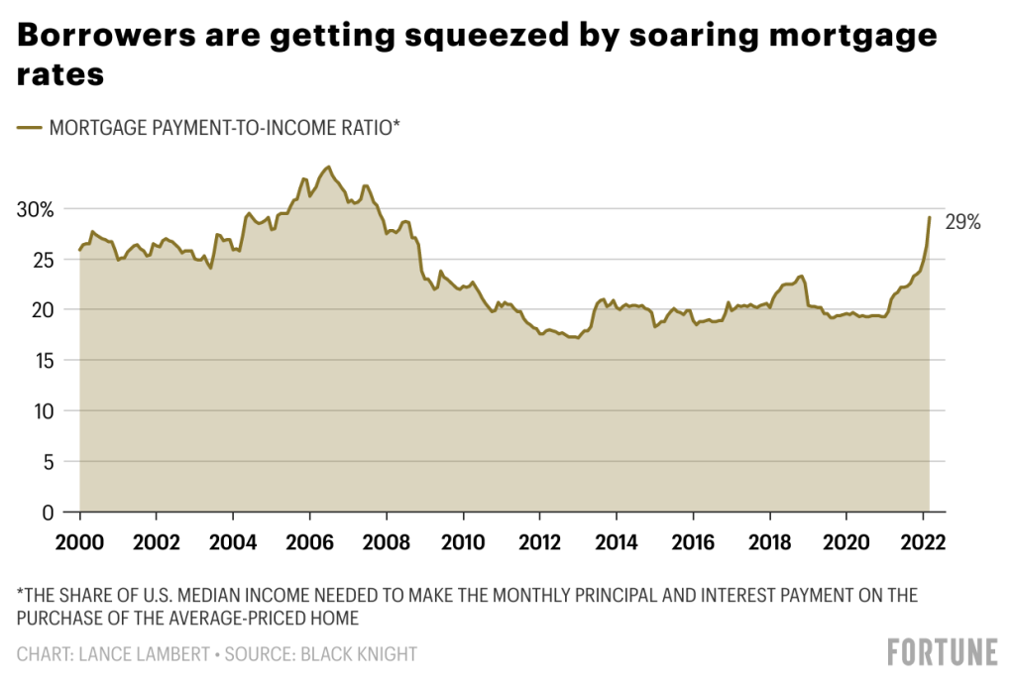
Economic Impact
Notes:
While many welcomed the increased wages, it wasn’t long before the increased wages triggered action from the Federal Reserve which has raised the rate of inflation. In September 2021, Choudhary (2021) noted that the average increase in hourly earnings was 4.3%. By comparison, the annual inflation rate in February 2022 had risen to 7.9% (Trading Economics, n.d.). The war in Ukraine coupled with continued volatility in the labor market could lead to further elevated inflation rates. This is unsustainable for employers, the economy, and the population.

Slide 7
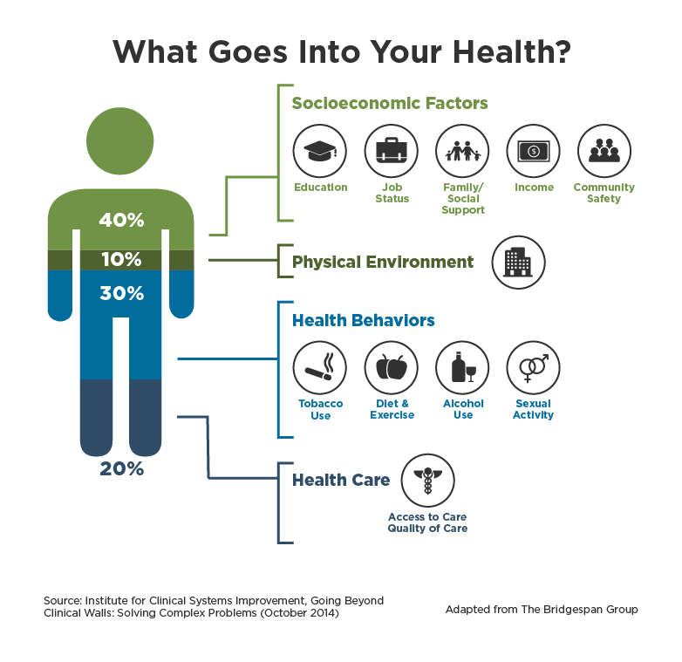
Population Health Impact
Notes:
Health status has historically been unevenly distributed in the U.S. as demonstrated by lower life expectancies among the poorest Americans (Maani & Galea, 2020). A further reduced life expectancy for minority groups has also been noted by CDC (Brenner, 2021). Pandemic prevention measures altered the population’s food consumption, exercise behaviors, limited access to nutritious food, and overall quality of life (Rogers et al.,2021).
Psychologically, population segments have been more exposed to apprehension, feelings of depression, and stress resulting from trauma (Saladino et al., 2020). Young adults and children are at higher risk of developing anxiety while health care workers are at higher risk of developing mental and physical health issues most seen following catastrophic situations (Saladino et al., 2020).
The pandemic reduced timely access to preventative care as health organizations struggled to keep up with the waves of COVID 19 patients. Understanding the long-term impact of the disruptions in care caused by the pandemic will require further research to create mitigation and long-term recovery strategies (Papautsky et al., 2020). The pandemic is likely to have extended repercussions as it has delayed care, contributed to unhealthy behaviors, made changes to physical environments, and further threatened socioeconomic factors… all of which are determinants of health (Rigby, 2021).

Slide 8
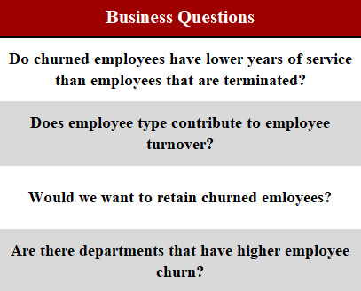

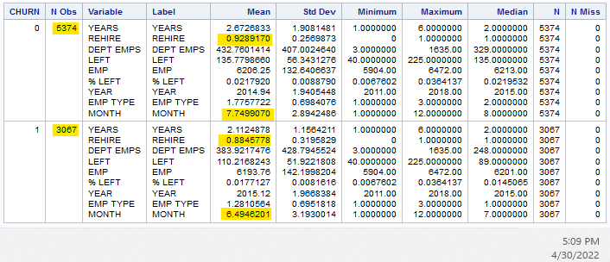
Study Overview
Notes:
The employee turnover dataset was obtained from Louisville (KY) Metro Open Data page ("Turnover," 2021). The dataset contains the count of employees that left the Metro Government each month spanning from 2011 to 2018. The turnover dataset was modified for analysis and converted to the churn dataset. The churn dataset contains 8,441 observations of 13 variables.
The target variable for analysis is CHURN, defined as employees who left voluntarily. The employees that did not churn, were involuntarily let go by the organization. The preliminary questions and hypotheses for the research project are shown in the Figure on the left and a portion of the summary statistics is shown on the right.
The CHURN and REHIRE variables are Boolean where 0 indicates no and 1 indicates yes. The MONTH variable corresponds to the numerical calendar month.

Slide 9
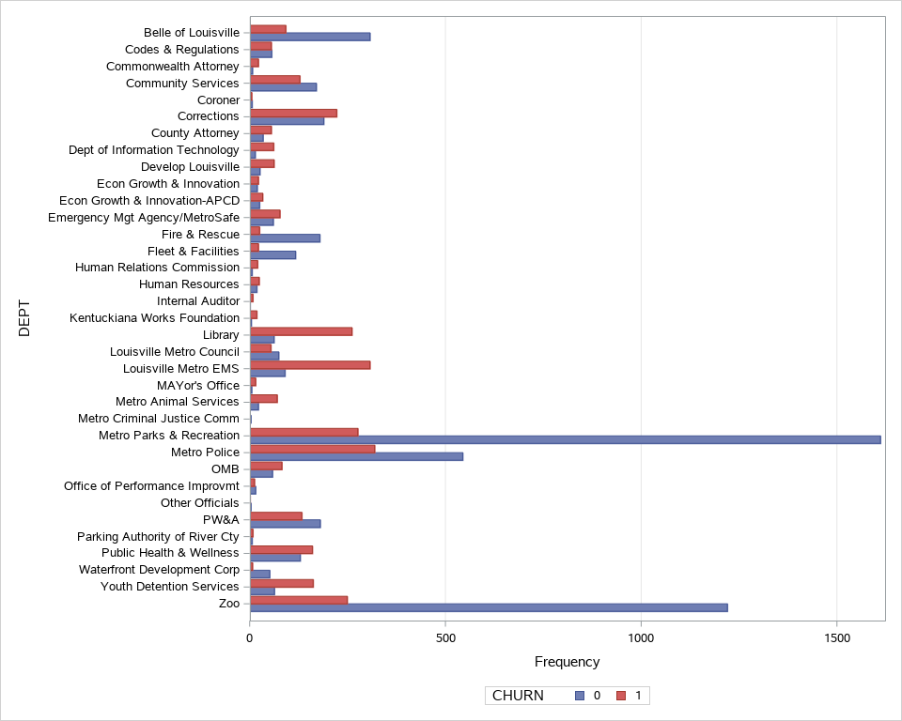
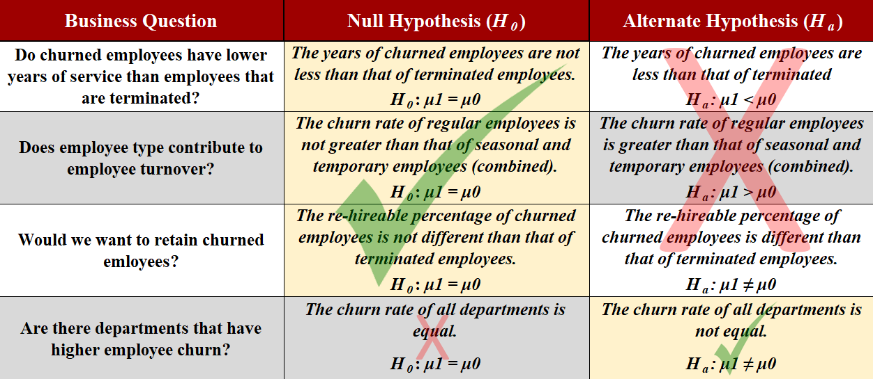
Findings & Analysis
Notes:
It was interesting to note that of the 8,441 employees that left the organization, 36.3% left voluntarily (churned) while the majority (63.7%) were involuntarily let go as they were seasonal and temporary employees. The mean of the REHIRE variable for both classifications indicates that most of the employees the leave are eligible for rehire. It was also noted that July and June are the months with the greatest turnover. For the dataset, EMP TYPE, YEARS, and MONTH are the stronger indicators of churn.
At the 95% confidence level, the p-values (0.0001) indicate that the null hypothesis is accepted for the first 3 questions. A visible inspection of the churn by the department indicates that the null hypothesis should be rejected for the final question. The results of business question 3 were of particular interest as was the fact that 63.7% of the churned employees were involuntarily terminated. It makes more sense, given the cost of hiring/training employees and the current labor market, to increase efforts to retain employees.

Slide 10

Limitations
Data availability
Insufficient Variables
Stale data
x
x
x
Notes:
Personal access to a dataset was limited so a secondary dataset was procured (O’Leary, 2021). The existing dataset was able to provide some insight as to the seasonality of involuntary turnover, but it lacked variables that may help identify the motivation behind the voluntary resignations. This may be because the turnover dataset originally contained summary data. The ideal scenario would be to obtain a dataset that includes post-pandemic data to provide clearer insight regarding the current reasons for employee turnover. Variables that indicate things that impact employee work-life balance should likewise be collected (e.g., commute distance, remote or on-site, benefit status).

Slide 11

Conclusion
Notes:
The Covid-19 pandemic will have enduring effects on the nation’s population health and economy. Identifying factors that contribute to employee turnover will allow organizations to abate it. As more recent data becomes available, additional analysis will need to be conducted. Identifying and responding to emerging contributors to voluntary employee turnover will aid in stabilizing the employment market and ultimately can improve the nation’s economic and population health.

Slide 12
References
Antia, R., & Halloran, M. E. (2021). Transition to endemicity: Understanding COVID-19. Immunity, 54(10), 2172-2176. https://doi.org/10.1016/j.immuni.2021.09.019
BLS. (2022, March 31). Job openings and labor turnover survey. U.S. Bureau of Labor Statistics. https://www.bls.gov/jlt/data.htm#
Brenner, M. H. (2021). Unemployment, bankruptcies, and deaths from multiple causes in the COVID-19 recession compared with the 2000‒2018 Great Recession impact. American Journal of Public Health, 111(11), 1950-1959. https://doi.org/10.2105/ajph.2021.306490
CDC Museum. (2022, January 5). CDC Museum COVID-19 timeline. Centers for Disease Control and Prevention | CDC. https://www.cdc.gov/museum/timeline/covid19.html
Choudhary, V. (2021, September 24). US hiring surges as COVID benefits expire, supply chain hit bites; Wage inflation in focus. TheStreet. https://www.thestreet.com/investing/us-hiring-surges-as-covid-benefits-expire-supply-chain-hit-bites
Geisler, J. (2021). The Great Resignation: Reality or myth? HFM (Healthcare Financial Management), 75(7), 44-45.
Jagangac, J., Gavric, T., & Obhodas, I. (2020). Effects of work stress and job satisfaction on employee retention: A model of retention strategies. International Journal of Sales, Retailing & Marketing, 9(2), 38-50.
Maani, N., & Galea, S. (2020). COVID‐19 and underinvestment in the health of the US population. The Milbank Quarterly, 98(2), 239-249. https://doi.org/10.1111/1468-0009.12462
O′Leary, Z. (2021). The essential guide to doing your research project (4th ed.). SAGE.
Rigby, E. (2021). The COVID-19 economy, unemployment insurance, and population health. JAMA Network Open, 4(1), e2035955. https://doi.org/10.1001/jamanetworkopen.2020.35955
Rogers, A. M., Lauren, B. N., Woo Baidal, J. A., Ozanne, E. M., & Hur, C. (2021). Persistent effects of the COVID-19 pandemic on diet, exercise, risk for food insecurity, and quality of life: A longitudinal study among U.S. adults. Appetite, 167, 105639. https://doi.org/10.1016/j.appet.2021.105639
Saladino, V., Algeri, D., & Auriemma, V. (2020). The psychological and social impact of COVID-19: New perspectives of well-being. Frontiers in Psychology, 11. https://doi.org/10.3389/fpsyg.2020.577684
Shi, & Singh, D. A. (2019). Delivering health care in America (7th ed.). Jones & Bartlett Learning Trading Economics. (n.d.). United States inflation rate | 1914-2021 data | 2022-2023 forecast | Calendar. TRADING ECONOMICS | 20 million INDICATORS FROM 196 COUNTRIES. https://tradingeconomics.com/united-states/inflation-cpi
Trading Economics. (n.d.). United States inflation rate | 1914-2021 data | 2022-2023 forecast | Calendar. TRADING ECONOMICS | 20 million INDICATORS FROM 196 COUNTRIES. https://tradingeconomics.com/united-states/inflation-cpi
Turnover. (n.d.). Louisville Metro Open Data. https://data.louisvilleky.gov/dataset/turnover
Notes:
Antia, R., & Halloran, M. E. (2021). Transition to endemicity: Understanding COVID-19. Immunity, 54(10), 2172-2176. https://doi.org/10.1016/j.immuni.2021.09.019
BLS. (2022, March 31). Job openings and labor turnover survey. U.S. Bureau of Labor Statistics. https://www.bls.gov/jlt/data.htm#
Brenner, M. H. (2021). Unemployment, bankruptcies, and deaths from multiple causes in the COVID-19 recession compared with the 2000‒2018 Great Recession impact. American Journal of Public Health, 111(11), 1950-1959. https://doi.org/10.2105/ajph.2021.306490
CDC Museum. (2022, January 5). CDC Museum COVID-19 timeline. Centers for Disease Control and Prevention | CDC. https://www.cdc.gov/museum/timeline/covid19.html
Choudhary, V. (2021, September 24). US hiring surges as COVID benefits expire, supply chain hit bites; Wage inflation in focus. TheStreet. https://www.thestreet.com/investing/us-hiring-surges-as-covid-benefits-expire-supply-chain-hit-bites
Geisler, J. (2021). The Great Resignation: Reality or myth? HFM (Healthcare Financial Management), 75(7), 44-45.
Jagangac, J., Gavric, T., & Obhodas, I. (2020). Effects of work stress and job satisfaction on employee retention: A model of retention strategies. International Journal of Sales, Retailing & Marketing, 9(2), 38-50.
Maani, N., & Galea, S. (2020). COVID‐19 and underinvestment in the health of the US population. The Milbank Quarterly, 98(2), 239-249. https://doi.org/10.1111/1468-0009.12462
O′Leary, Z. (2021). The essential guide to doing your research project (4th ed.). SAGE.
Rigby, E. (2021). The COVID-19 economy, unemployment insurance, and population health. JAMA Network Open, 4(1), e2035955. https://doi.org/10.1001/jamanetworkopen.2020.35955
Rogers, A. M., Lauren, B. N., Woo Baidal, J. A., Ozanne, E. M., & Hur, C. (2021). Persistent effects of the COVID-19 pandemic on diet, exercise, risk for food insecurity, and quality of life: A longitudinal study among U.S. adults. Appetite, 167, 105639. https://doi.org/10.1016/j.appet.2021.105639
Saladino, V., Algeri, D., & Auriemma, V. (2020). The psychological and social impact of COVID-19: New perspectives of well-being. Frontiers in Psychology, 11. https://doi.org/10.3389/fpsyg.2020.577684
Shi, & Singh, D. A. (2019). Delivering health care in America (7th ed.). Jones & Bartlett Learning Trading Economics. (n.d.). United States inflation rate | 1914-2021 data | 2022-2023 forecast | Calendar. TRADING ECONOMICS | 20 million INDICATORS FROM 196 COUNTRIES. https://tradingeconomics.com/united-states/inflation-cpi
Trading Economics. (n.d.). United States inflation rate | 1914-2021 data | 2022-2023 forecast | Calendar. TRADING ECONOMICS | 20 million INDICATORS FROM 196 COUNTRIES. https://tradingeconomics.com/united-states/inflation-cpi
Turnover. (n.d.). Louisville Metro Open Data. https://data.louisvilleky.gov/dataset/turnover

